Slide 1

Weather Conditions and Climate Change with ClimateWins
Kaan ARSLAN
kaan@kaanarslan.com

Slide 2

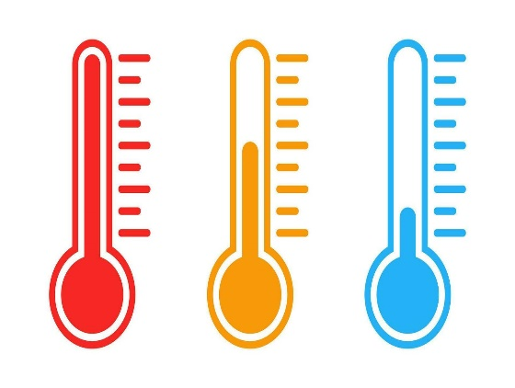
Weather Conditions and Climate Change with ClimateWins
<//
//>
Objective
To use machine learning to help predict the consequences of climate change while working as a data analyst at a European nonprofit organization
Hypotheses
Machine learning can identify early indicators of long-term climate shifts by detecting subtle patterns in temperature variability, precipitation trends, and extreme event frequency that traditional analysis may overlook.
Machine learning can classify whether daily weather conditions will be pleasant or unpleasant by learning from historical patterns of temperature, wind speed, humidity and cloud cover.
Machine learning can estimate the probability of hazardous weather events, such as; storms, heatwaves, or sudden temperature drops by recognizing precursor signals in multivariate climate data.

Slide 3
Weather Conditions and Climate Change with ClimateWins
<//
//>
Context
ClimateWins aims to evaluate how machine learning can be applied to historical European weather data to classify daily conditions and support long-term climate forecasting.
The project uses more than a century of observations from 18 weather stations, enabling supervised and unsupervised techniques to be tested, compared and optimized for strategic decision making.
Data
Collected by the European Climate Assessment & Dataset Project
The dataset contains daily measurements; temperature, wind speed, precipitation, snow and radiation that collected from 18 European weather stations spanning the late 1800s to 2022.
It’s long temporal range and multivariate structure make it suitable for both supervised and unsupervised machine learning, enabling pattern detection, trend analysis, and weather-condition classification.

Slide 4

Weather Conditions and Climate Change with ClimateWins
<//
//>
Potential data biases
Privacy Bias: Climate datasets may indirectly expose personal or location-specific information, requiring strong anonymisation.
Regional Bias: Long-term, high-density data from Europe and North America contrasts with sparse records elsewhere, creating geographic imbalance.
Collection Bias: Human decisions in station placement, technology and measurement priorities introduce systematic errors that models inherit.
Decision Bias: Models may misinterpret long-term climate shifts, leading to faulty predictions that disproportionately harm vulnerable populations.

Slide 5
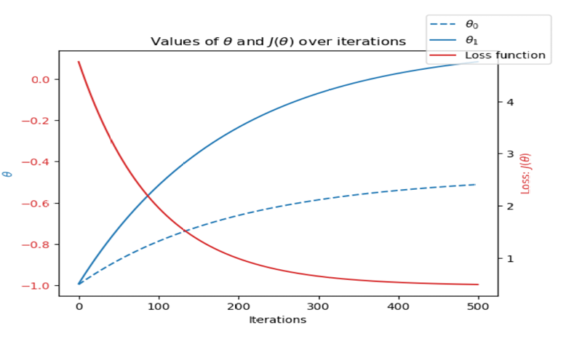
Data optimization
<//
//>
Gradient descent technique is used to optimize data.
By using gradient descent;
Improves model accuracy by iteratively refining parameters instead of relying on manual tuning.
Provides a systematic way to minimise the loss function by updating weights in the direction of steepest descent.
Converges toward optimal solutions even when starting from poor initial parameter values.
Visualises learning progress clearly: loss decreases over time while parameters stabilise, confirming effective optimisation.

Slide 6
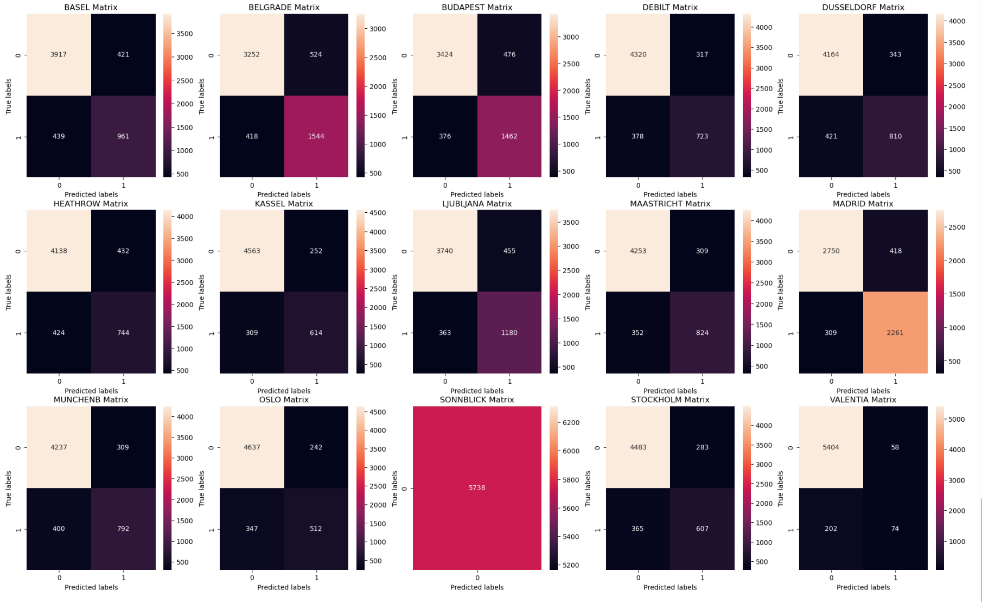
Alghorithm 1: K-nearest neighbour (KNN)
<//
//>
k-Nearest Neighbors classifies a new data point by finding the k most similar points in the dataset and assigning the majority class among those neighbours.
Average testing accuracy was 88%, with most stations reaching 90–95% reliability.
Sonnblick’s 100% accuracy is misleading because the dataset contains only one class.
No major overfitting observed
Slight overfitting may appear with small neighbour values and more varied data is needed for better class separation.

Slide 7
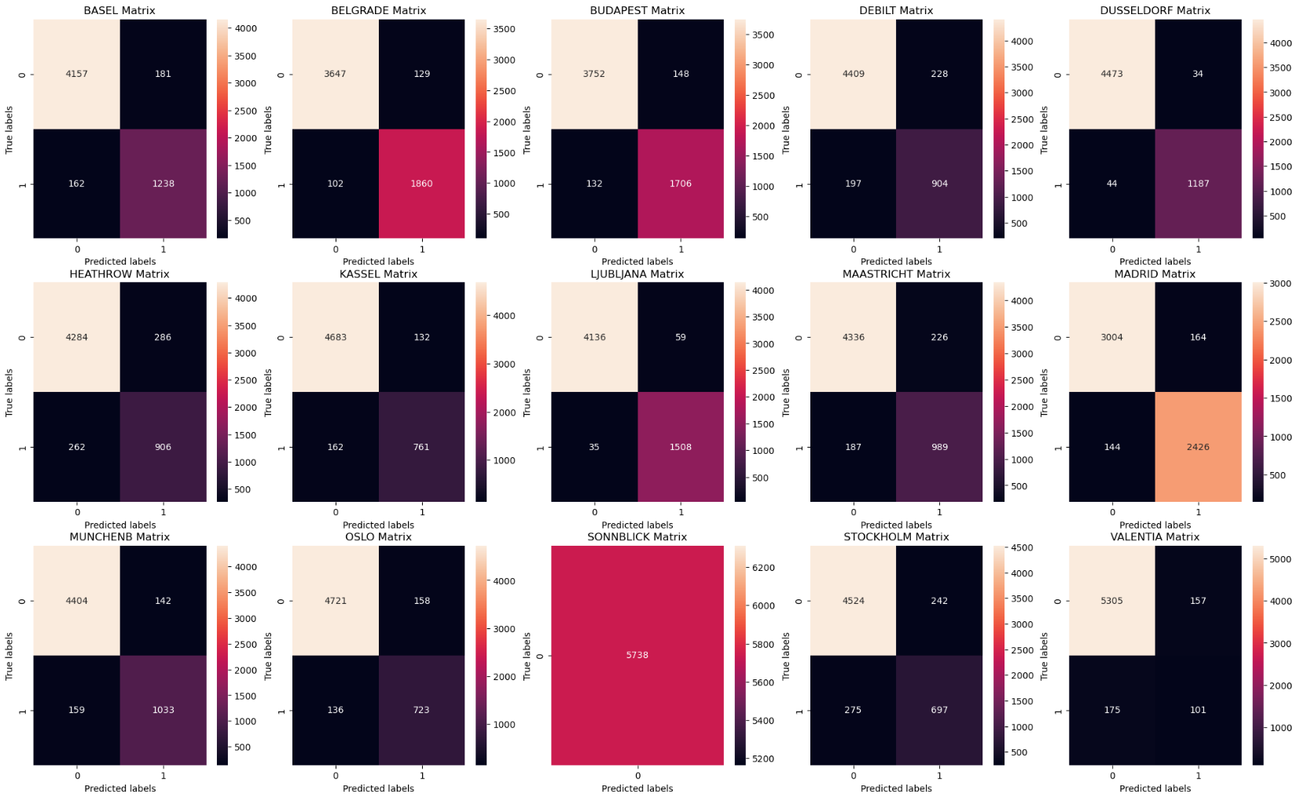
Alghorithm 2: Decision Tree
<//
//>
A decision tree is a classification method that predicts outcomes by splitting data into branches based on the most informative features.
Training accuracy reached 60% and testing accuracy 63%, and the overall process was slow due to the model evaluating many split possibilities.
Decision tree should be pruned because its too complex and hard to interpret

Slide 8
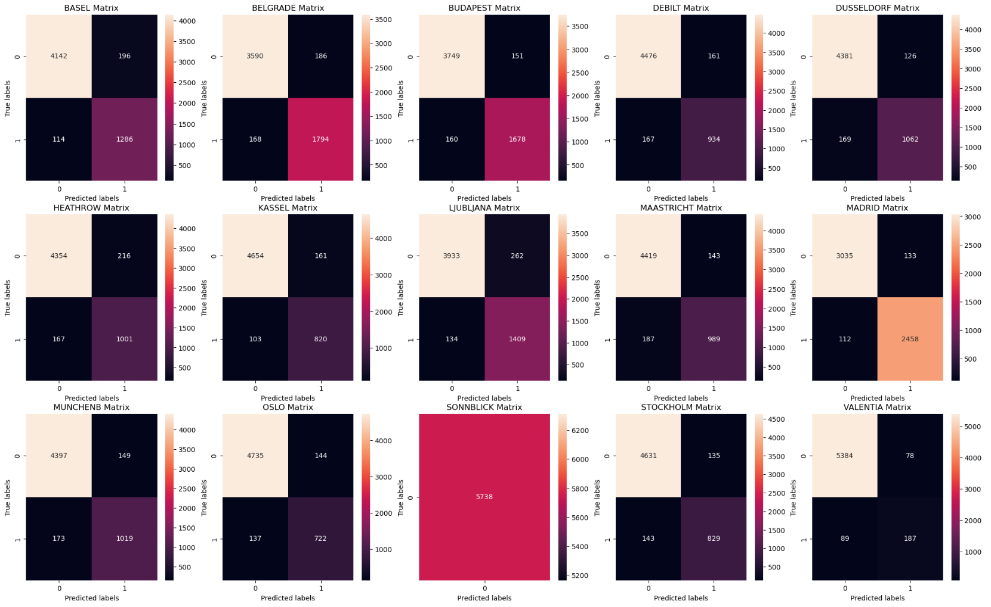
Alghorithm 3: Artifical neural network (ANN)
<//
//>
An Artificial Neural Network (ANN) is a model inspired by the structure of the human brain, learning patterns by adjusting interconnected layers of weighted nodes.
Testing accuracy reached 92% while the highest training accuracy remained around 72% showing the model generalised well but learned less from the training set.

Slide 9
Next steps
<// //>
Expand the dataset by incorporating additional weather stations
Reevaluate the Sonnblick station by replacing or augmenting its dataset, as the current single class structure prevents the model from learning any meaningful decision boundaries.
Hypotheses will be tested using an ANN;
Machine learning can detect early signs of long-term climate change by finding subtle patterns in temperature, precipitation and extreme event frequency.
Machine learning can classify each day as pleasant or unpleasant by learning from historical weather patterns across multiple variables.
Machine learning can estimate the likelihood of hazardous weather events by identifying early warning signals within multivariate climate data.

Slide 10
Summary
<// //>
ANN should be preferred overall. Although K-neighbour appears to achieve the high accuracy, its performance declines with higher dimensionality, making it less suitable for complex, multivariate climate data. In contrast, ANN learn nonlinear relationships more effectively and provide stronger predictive capability across diverse features. For this reason, ANNs carry greater analytical value and reliability in hypothesis testing within this project.

Slide 11
<//Contact//>
kaan@kaanarslan.com
kaan@kaanarslan.com
Github & Tableau public
CREDITS: This presentation template was created by Slidesgo, including icons by
Flaticon and infographics & images by Freepik

